Slide 1
Operating Systems
  Lecture X: UNIX File System
  Yu Chen (陈渝)
  Department of Computer Science & Technology
  Tsinghua University
  2017.06.16

Slide 2

Outline
Background
Basic Concepts
User View
Kernel View
Notes:
The difference between memory and disk storage: size, speed, persistence
File system:
1)easy to access for human being;
2)efficiency of reading, writing, and indexing;
Different goals, different file systems;

Slide 3



Background
Why File System?
Video
Book
Picture
Notes:
The difference between memory and disk storage: size, speed, persistence
File system:
1)easy to access for human being;
2)efficiency of reading, writing, and indexing;
Different goals, different file systems;

Slide 4
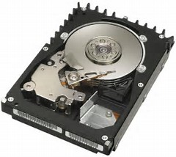

Background
Why File System?
Video
Book
Picture
Notes:
The difference between memory and disk storage: size, speed, persistence
File system:
1)easy to access for human being;
2)efficiency of reading, writing, and indexing;
Different goals, different file systems;

Slide 5
Background
Why File System?
Video
Book
Picture
Files
Files
Files
File System
Notes:
The difference between memory and disk storage: size, speed, persistence
File system:
1)easy to access for human being;
2)efficiency of reading, writing, and indexing;
Different goals, different file systems;

Slide 6
Background
Why File System?
Must store large amounts of data
Information stored must survive the termination of the process using it
Multiple processes must be able to access the information concurrently
Performance
Reliability
Security
Notes:
The difference between memory and disk storage: size, speed, persistence
File system:
1)easy to access for human being;
2)efficiency of reading, writing, and indexing;
Different goals, different file systems;

Slide 7
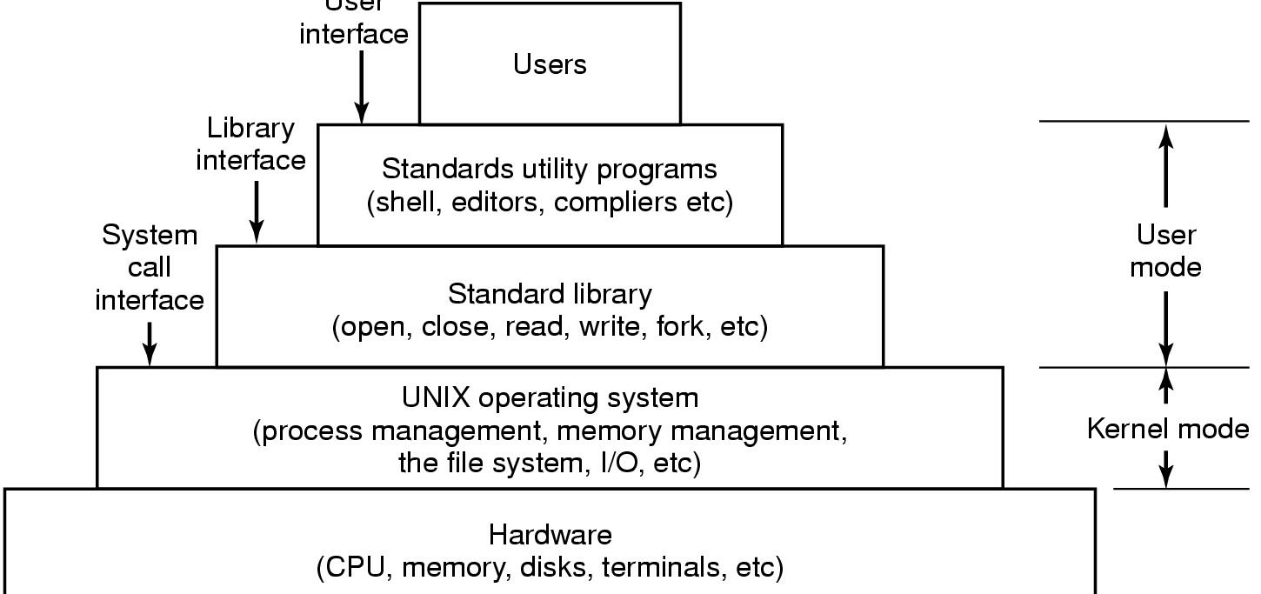
Background
User
Interface
The layers of a UNIX system.
Notes:
The difference between memory and disk storage: size, speed, persistence
File system:
1)easy to access for human being;
2)efficiency of reading, writing, and indexing;
Different goals, different file systems;

Slide 8

Background
UNIX philosophy
Everything is a file.
Small is beautiful.
Make each program do one thing well.
…
K. Thompson and D. Ritchie
Notes:
The difference between memory and disk storage: size, speed, persistence
File system:
1)easy to access for human being;
2)efficiency of reading, writing, and indexing;
Different goals, different file systems;

Slide 9
Outline
Background
Basic Concepts
User View
Kernel View
Notes:
The difference between memory and disk storage: size, speed, persistence
File system:
1)easy to access for human being;
2)efficiency of reading, writing, and indexing;
Different goals, different file systems;

Slide 10
User View
Definition
Functionality
Different Views
Organization
Mounting
Type of File
File Aliasing
File Operations
Notes:
The difference between memory and disk storage: size, speed, persistence
File system:
1)easy to access for human being;
2)efficiency of reading, writing, and indexing;
Different goals, different file systems;

Slide 11

File System and File
File System & File
File system: an OS abstraction for using persistent storage
  Organizing, manipulating, navigating, accessing, and retrieving data on the persistent storage
File: an OS abstraction for a unit of related data in the file system
  Open, Close, Read, Write, …
Notes:
File is a named persistent collection of data; a linear array of bytes with a one name.
To the kernel, data is unstructured, sequential bytes is accessed by specifying an offset from beginning of the file.
File attributes (metadata) include owner(s), permissions, time stamps, size etc.

Slide 12
File System Functionality
Allocate disk storage to files
  Managing file blocks (which blocks belong to which file)
  Managing free space (which blocks are free)
  Allocation algorithms (policies)
Notes:
Durability 1. 耐久性; 耐用性

Slide 13
File System Functionality
Allocate disk storage to files
  Managing file blocks (which blocks belong to which file)
  Managing free space (which blocks are free)
  Allocation algorithms (policies)
Manage the collection of files
  Locate files and their contents
  Naming: interface to find files by name
  Most common: hierarchical file system
  File system type (different ways to organize files)
Notes:
Durability 1. 耐久性; 耐用性

Slide 14
File System Functionality
Allocate disk storage to files
  Managing file blocks (which blocks belong to which file)
  Managing free space (which blocks are free)
  Allocation algorithms (policies)
Manage the collection of files
  Locate files and their contents
  Naming: interface to find files by name
  Most common: hierarchical file system
  File system type (different ways to organize files)
Provide convenience and features
  Protection: layers to keep data secure
  Reliability/Durability: Keeping of files durable despite crashes, media failures, attacks, etc
Notes:
Durability 1. 耐久性; 耐用性

Slide 15
User vs System View of a File
User’s view:
  Durable data structures
At system call interface
  Collection of bytes (UNIX)
  Doesn’t matter to system what kind of data structures you want to store on disk!
OS’s internal view
  Collection of blocks (a block is a logical transfer unit, while a sector is the physical transfer unit)
  Block size ≥ sector size; in UNIX, block size is 4KB

Slide 16
Translating from User to System View
What happens if user says: give me bytes 2—12?
  Fetch block corresponding to those bytes
  Return just the correct portion of the block
What about: write bytes 2—12?
  Fetch block
  Modify portion
  Write out Block
Everything inside File System is in whole size blocks
  For example, getc(), putc() ⇒ buffers something like 4096 bytes, even if interface is one byte at a time

Slide 17
User View
Definition
Functionality
Different Views
Organization
Mounting
Type of File
File Aliasing
File Operations
Notes:
The difference between memory and disk storage: size, speed, persistence
File system:
1)easy to access for human being;
2)efficiency of reading, writing, and indexing;
Different goals, different file systems;

Slide 18
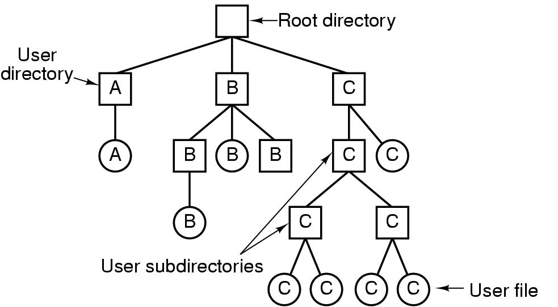
Organizing of UNIX File System
Files are organized in directories
Directory is a kind of special files
  Each contains a <name, pointer to file header> table
Tree structure for directories and files
  Some early file systems are flat (single-level directory)
Hierarchical name space

Slide 19
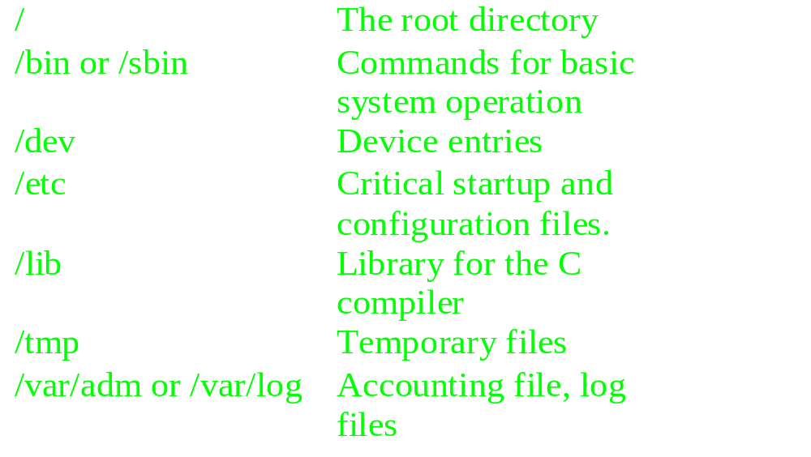
Organizing of UNIX File System

Slide 20

File System Mounting
A file system must be mounted before it can be accessed
A unmounted file system is mounted at a mount point
mount
point
unmounted
file system

Slide 21
User View
Definition
Functionality
Different Views
Organization
Mounting
Type of File
File Aliasing
File Operations
Notes:
The difference between memory and disk storage: size, speed, persistence
File system:
1)easy to access for human being;
2)efficiency of reading, writing, and indexing;
Different goals, different file systems;

Slide 22
Type of UNIX File
Regular Files
  binary
    GIF, JPEG, Executable etc.
  text
    scripts, program source code, documentation
  Supports sequential and random access
Directory
  Can contain ANY kind of files
  what is “.” and “..”??
Device File
  Allows programs to communicate with hardware.
  Kernel modules handles device management.

Slide 23
Type of UNIX File
Device Files (cont.)
  Character Device
    Accepts a stream of characters, without regard to any block structure.
    It is not addressable, therefore no seek operation
  Block Device
    Information stored in fixed-sized block
    It is addressable, therefore seek operation is possible.

Slide 24
Type of UNIX File
UNIX Domain Sockets (BSD)
  sockets that are local to a particular host and are referenced through a file system object rather than a network port.
  X windows
Named Pipe
  Allow processes to communicate with each other.

Slide 25

File Aliasing
Two or more different names referring same file
Hard Links: multiple directory entries point at the same file
Soft Links: “shortcut” pointers to other files
  Implemented by storing the logical name of actual file
/dict/count
/spell/count
/dict/w/list
/dict/all
/spell/words/list

Slide 26
File Aliasing
Hard links
  Linking files by reference
  System maintains a count of the number of links
  Does not work across file systems.
Soft links
  Linking files by name
  No counter is maintained
  Work across file system

Slide 27
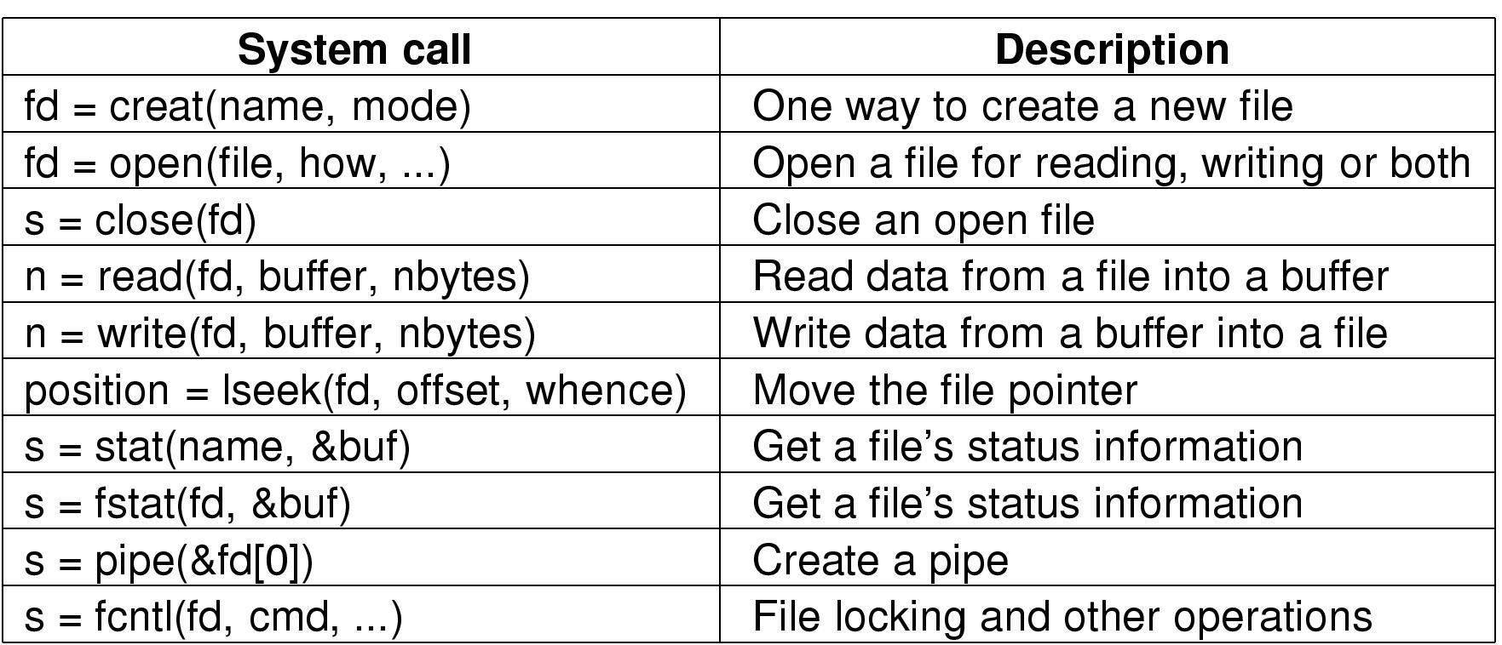
File Operations
s is an error code
fd is a file descriptor
position is a file offset

Slide 28
A rudimentary example:
#include <fcntl.h> /* controls file attributes */
#include<unistd.h> /* defines symbolic constants */
main()
{
int fd; /* a file descriptor */
ssize_t nread; /* number of bytes read */
char buf[1024]; /* data buffer */
/* open the file “data” for reading */
fd = open(“data”, O_RDONLY);
/* read in the data */
nread = read(fd, buf, 1024);
/* close the file */
close(fd);
}

Slide 29
Summary
All UNIX file system are very similar.
All file system have this concept of file tree.
  Transparent to user even mount point is mapped to a remote file system.
To communicate with devices, special device files are used.
More information check out the man pages.

Slide 30
Outline
Background
Basic Concepts
User View
Kernel View
Notes:
The difference between memory and disk storage: size, speed, persistence
File system:
1)easy to access for human being;
2)efficiency of reading, writing, and indexing;
Different goals, different file systems;

Slide 31
Kernel View
File System Imp.
VFS
Basic Data Structures/Abstractions
Abstract/Stoage/Kernel View
File Allocation
Free Space List
Notes:
The difference between memory and disk storage: size, speed, persistence
File system:
1)easy to access for human being;
2)efficiency of reading, writing, and indexing;
Different goals, different file systems;

Slide 32

File System Implementation in an OS
Layering structure
  Upper layer: virtual (logical) file system
  Lower layer: specific file system modules
File/File System API
Virtual File System layer
ext2
fat
UFS
nfs
smb
Device I/O
Network I/O

Slide 33
Virtual File System (VFS) Layer
Purpose
  Abstraction for all different file system implementations
Functions
  Provide the same file and file system interface
  Manage all file and file system related data structures
  Routines for efficient lookup, traverse the file system
  Interact with specific file system modules

Slide 34
UNIX File System Basic Data Structures
Volume Control Block (Unix: “superblock”)
  One per file system
  Detail information about the file system
  # of blocks, block size, free-block count/pointer, etc.
File Control Block (Unix: “vnode” or “inode”)
  One per file
  Detail information about the file
  Permission, owner, size, data block locations, etc.
Directory Node (Linux: “dentry”)
  One per directory entry (directory or file)
  A tree data structure to encode the directory structure and tree layout
  Pointer to file control block, parent, list of entries, etc.

Slide 35
Kernel View
File System Imp.
VFS
Basic Data Structures/Abstractions
Abstract/Stoage/Kernel View
File Allocation
Free Space List
Notes:
The difference between memory and disk storage: size, speed, persistence
File system:
1)easy to access for human being;
2)efficiency of reading, writing, and indexing;
Different goals, different file systems;

Slide 36
Abstract View
SuperBlock
dir
dir
dir
dir
dir
dir
dir
file
file
file
file
data
block
data
block
data
block
data
block
data
block
data
block
data
block
data
block
data
block

Slide 37
Where are the Data Structure Stored
File system data structures
  Volume control block /Super Block (one per file system)
  File control block (one per file)
  Directory node (one per directory entry)
Persistently stored on the secondary storage
  In data block(s) allocated in the storage
Loaded to memory when needed
  Volume control block: in memory if file system is mounted
  File control block: if the file is accessed
  Directory node: during traversal of a file path

Slide 38
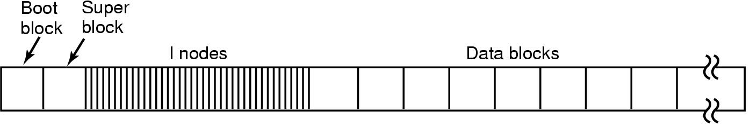
Storage View
Disk layout in classical UNIX systems

Slide 39
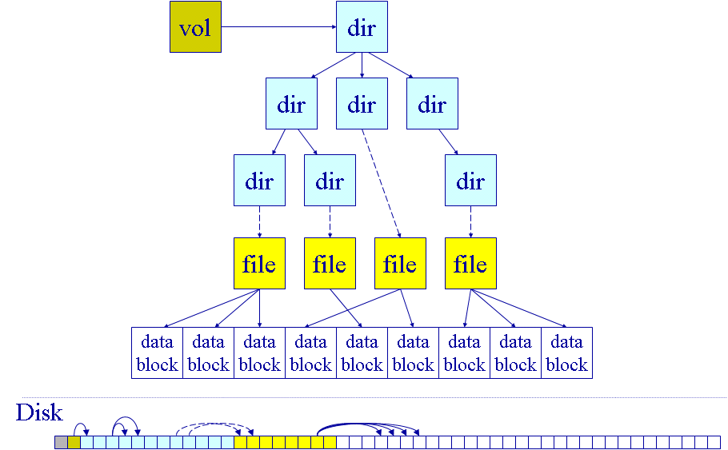
Storage View
SuperBlock

Slide 40
Kernel View
Subdirectories in more detail:
Directory ben
123
“.”
247
“..”
260
“book”
401
“memos”
Directory book
Directory memos
260
“.”
401
“.”
123
“..”
123
“..”
566
“chap1”
800
“kh”
567
“chap2”
810
“kd”
590
“chap3”
590
“mw”

Slide 41
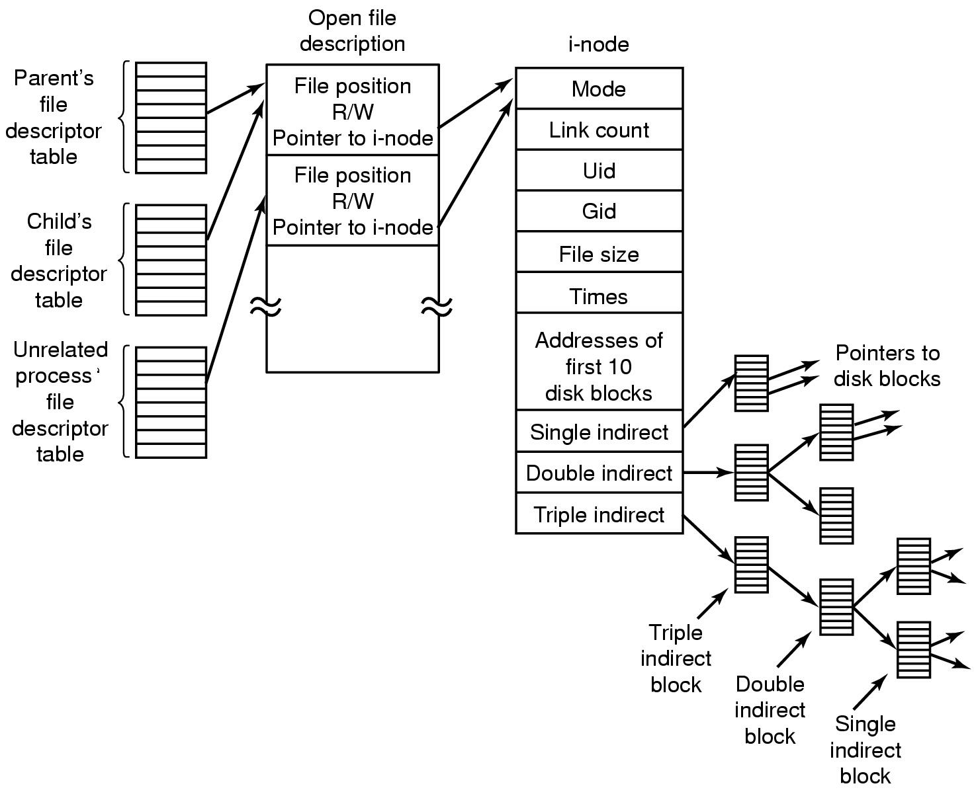
Kernel View

Slide 42
File System Data Structures for Open Files
Open file descriptor
  One per open file
  Information about the file status
  Directory entry, current file pointer, set of file ops, etc.
Open file tables
  One per process
  One system-wide
  Each volume control block should keep a list too
  So that it wouldn’t dismount if still open file(s)

Slide 43
Kernel View
File System Imp.
VFS
Basic Data Structures/Abstractions
Abstract/Stoage/Kernel View
File Allocation
Free Space List
Notes:
The difference between memory and disk storage: size, speed, persistence
File system:
1)easy to access for human being;
2)efficiency of reading, writing, and indexing;
Different goals, different file systems;

Slide 44
File Allocation
How to allocate data blocks to each file
Allocation methods
  Contiguous allocation
  Linked allocation
  Indexed allocation
Metrics
  Efficiency: e.g., storage utilization (external fragmentation)
  Performance: e.g., access speed

Slide 45

Contiguous Allocation
File header specifies starting block & length
Placement/Allocation policies
  First-fit, best-fit, ...
Pluses
  Best file read performance
  Efficient sequential & random access
Minuses
  Fragmentation!
  Problems with file growth
    Pre-allocation?
    On-demand allocation?
Notes:
Now we look look at methods for allocating space to files.
— The compliment of the free-list representation problem.
Contiguous allocation also gives the best performance for the initial write of a file (i.e., once space has been allocated).
— Subsequent writes may cause the file to grow in which case it may have to be copied and moved.

Slide 46
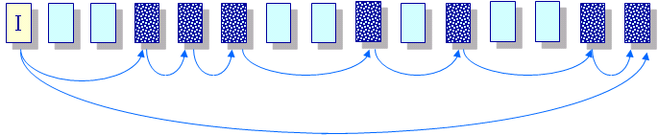
Linked Allocation
Files stored as a linked list of blocks
File header contains a pointer to the first and last file blocks
Pluses
  Easy to create, grow & shrink files
  No fragmentation
Minuses
  Impossible to do true random access
  Reliability
    Break one link in the chain and...
Notes:
Why have a pointer to the last block?
— Makes it easy to grow the file. You don’t have to scan the chain to find the end of the list.

Slide 47
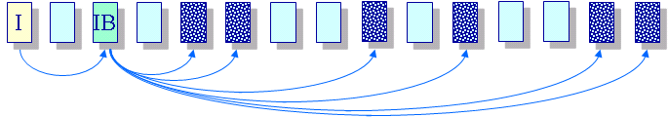
Indexed Allocation
Create a non-data block for each file called the index block
  A list of pointers to file blocks
File header contains the index block
Pluses
  Easy to create, grow & shrink files
  No fragmentation
  Supports direct access
Minuses
  Overhead of storing index when files are small
  How to handle large files?
Notes:
If a disk pointer is 32 bits (we can address up to 4 billion sectors), then:
— An index block can contain 512/32 = 16 pointers, so
— Under indexed allocation, a file can be 16×512 = 8K bytes
(using the Seagate disk example).

Slide 48
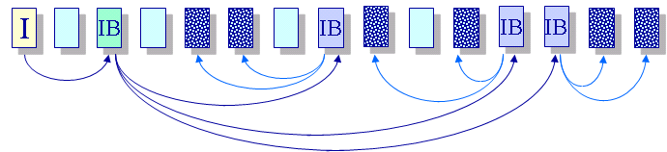
Indexed Allocation for Large Files
Multilevel index blocks (IB*IB*…)
Notes:
(Draw these out again in the margin using a more tree-like structure...)

Slide 49
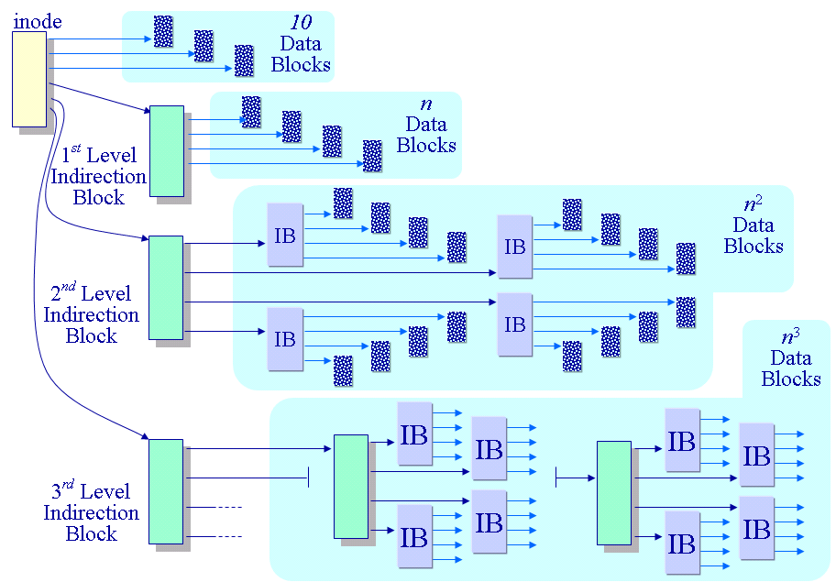
Multi-level Indexed Allocation in UNIX Files
Notes:
In this figure n is the number of pointer you can store in a disk block.
Assuming a first level block can contain 256 (=1KB/4) pointers then
— a “small” file is 256 K bytes = 1KB * 256
— a “medium” file is 64 MB = 1KB * 256 *256
— a “large” file is 16 GB! = 1KB * 256 *256 *256

Slide 50
Multi-level Indexed Allocation in UNIX Files
File header contains 13 pointers
  10 pointes to data blocks;
  11th pointer → indirect block;
  12th pointer → doubly-indirect block;
  13th pointer → triply-indirect block
Implications
  Upper limit on file size
  Blocks are allocated dynamically, files can easily expand
  Small files are cheap
  Allocate indirect blocks only for large files, and large files require a lot of seek to access indirect blocks

Slide 51
Kernel View
File System Imp.
VFS
Basic Data Structures/Abstractions
Abstract/Stoage/Kernel View
File Allocation
Free Space List
Notes:
The difference between memory and disk storage: size, speed, persistence
File system:
1)easy to access for human being;
2)efficiency of reading, writing, and indexing;
Different goals, different file systems;

Slide 52
Free-Space List
Keep track of all unallocated blocks in the storage
Where is free-space list stored?
What is a good data structure for free-space list?

Slide 53
Free-Space List: Bit Map
Represent the list of free blocks as a bit map:
  111111111111111001110101011101111...
  If bit i = 0 then block i is free, otherwise it is allocated
Simple to use but this can be a big vector:
  160GB disk -> 40M blocks -> 5MB worth of bits
  However, if free sectors are uniformly distributed across the disk then the expected number of bits that must be scanned before finding a “0” is n/r, where
    n = total number of blocks on the disk
    r = number of free blocks
  If a disk is 90% full, then the average number of bits to be scanned is 10, independent of the size of the disk
Notes:
One of the key things a directory must do is make it easy to allocate new space on the disk.
— The directory must keep track of which blocks are free and which are allocated.
Often CPUs have instructions to perform this search in a small number of machine cycles.
But are free blocks uniformly spread out over the disk?
— Not likely. If they were then file I/O performance would likely be poor.
160GB/4KB = 40M blocks
40M/8bit = 5MB

Slide 54
Free-Space List: Bit Map (Cont.)‏
Need to protect:
  Pointer to free list
  Bit map
    Must be kept on disk
    Copy in memory and disk may differ.
    Cannot allow for block[i] to have a situation where bit[i] = 1 in memory and bit[i] = 0 on disk.
  Solution:
    Set bit[i] = 1 in disk.
    Allocate block[i]
    Set bit[i] = 1 in memory ？

Slide 55
Kernel View Summary
File System Imp.
VFS
Basic Data Structures/Abstractions
Abstract/Stoage/Kernel View
File Allocation
Free Space List
Notes:
The difference between memory and disk storage: size, speed, persistence
File system:
1)easy to access for human being;
2)efficiency of reading, writing, and indexing;
Different goals, different file systems;

Slide 56
New UNIX File Support
Issues with the old UNIX file system – fragmentation, performance, reliability..
BSD Fast File System (FFS) - BSD
Journaled File Systems (JFS) - AIX
Log-based file systems (LFS) – Various OS
Network File System (NFS) - Solaris

